Slide 1
Deep Learning 调研

Slide 2
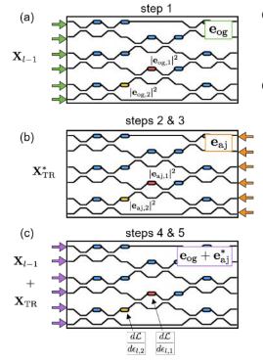
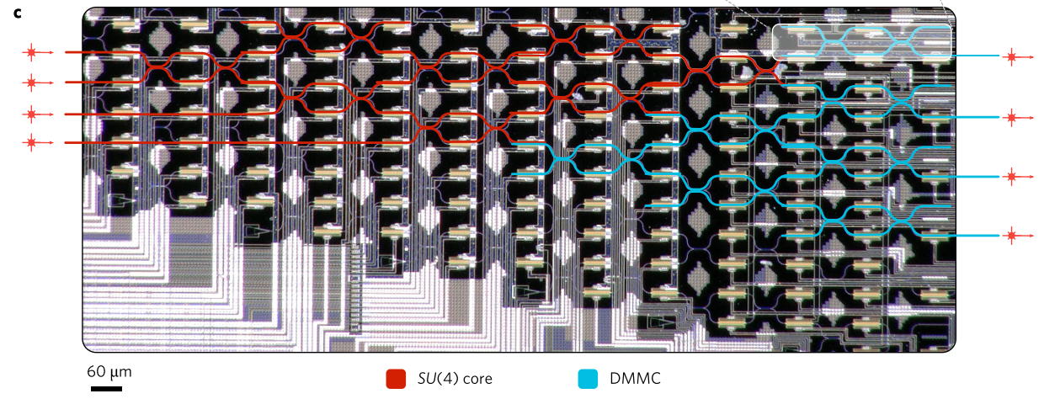
Shanhui Fan et al., “In-situ Backpropagation in Photonic Neural Networks”, Frontiers in Optics/ Laser Science, 2018.
improved from
physically implementing adjoint variable method
in situ intensity measurements.
Shen Yichen etal., Deep learning with coherent nanophotonic circuits, Nature Photonics, 2017
Schematic illustration of the proposed method for experimental measurement of gradient information within an optical interference unit; (a): forward pass; (b): backpropagation of the error signal; (c): interference measurement to recover the gradient of the objective function with respect to all degrees of freedom simultaneously.

Slide 3
改进
对原文献的评价：the training of the phase-shifter settings for this system was performed using a model implemented on a standard computer, which does not take into account experimental errors, and furthermore loses all the potential advantages in time and energy of the photonic implementation.
改进：The only additional component that is required is a means to measure the light intensity in the vicinity of each of the tunable phase shifters.

Slide 4
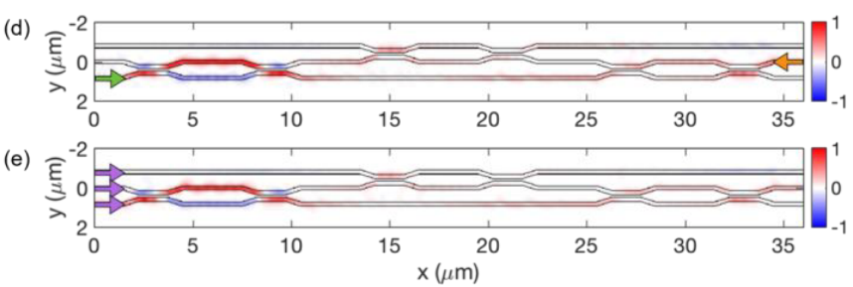
Restriction
This procedure for the gradient computation is exact if we assume a lossless, reciprocal, feed-forward propagation inside the OIU, which is to a good approximation true.
40% of the light is lost due to back-scattering and radiation losses
Shanhui Fan et al., “In-situ Backpropagation in Photonic Neural Networks”, Frontiers in Optics/ Laser Science, 2018.

Slide 5
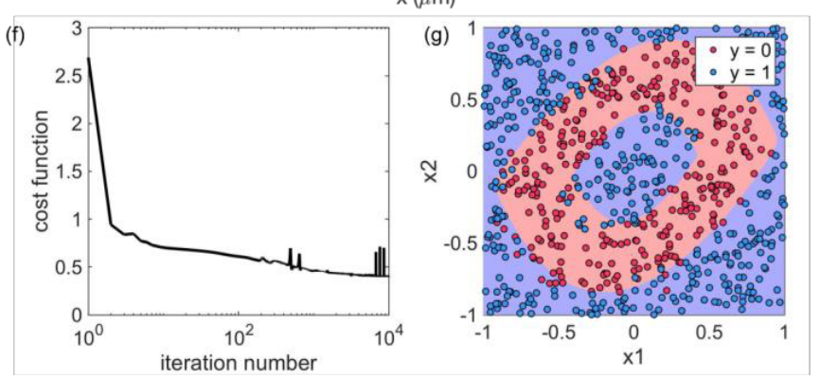
Results
91% precision
Shanhui Fan et al., “In-situ Backpropagation in Photonic Neural Networks”, Frontiers in Optics/ Laser Science, 2018.

